Slide 1
Tailly
Get your best fit

Slide 2
TABLE OF CONTENTS
01
Abstract
02
Methodology
03
USP
04
Social Impact
05
Market Competitors
06
Future Scope

Slide 3
01 Abstract
The website is a connection between customers and the tailors. We try to develop a common platform for the customers and tailors, where they can communicate for the orders and customers can get verity while choosing for tailor and tailors can get good platform to showcase their availability and talents.

Slide 4
Problem Statement
Many tailors do not get employment the whole year.
In this era of technology, we found the gap of online connection between the tailors and the customers.
So, to fill the gap we try to develop a platform where customer can connect to the near by and desired tailor.

Slide 5
People –System Involved
A
B
C
User
Application
Tailor
User will sign up and place order choosing the (nearby) tailor.
Our website will choose the delivery boy to pick the customers cloth and the measurement.
Tailor will be registered in the website and they can approve the order.

Slide 6
02 Methodology

Slide 7
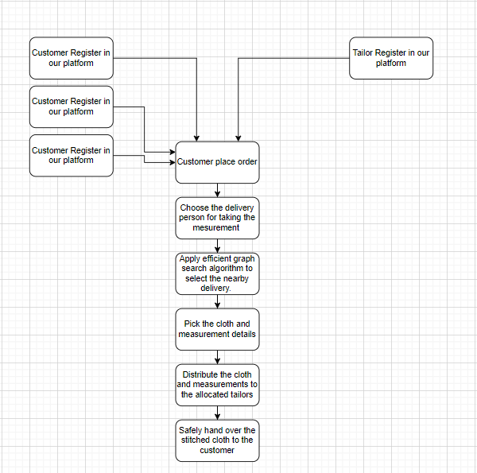

Slide 8
Application
User
Tailor
Login and place order
Register and get the order
Measurement
Delivery
Give the cloth and measurement and payment
App search for the nearby delivery boy
Recieve
Get the review
Get back the cloth and review
App will provide the review to the tailor

Slide 9
03 Social Impact
In India there are very few online platform which work on the same problem.
Finding a good tailor in less time.
More job opportunities for the tailors.
Showcasing the talent of individual tailor.

Slide 10
04 Unique Selling Point
The unique selling point of our idea is the convenience and efficiency it offers to both tailors and customers.
An online interface between tailors and customers
A range of styles and designs that may not be available in traditional retail stores. This allows customers to express their individuality and personal style through their clothing choices.
This eliminates the need for customers to physically visit tailors and saves them time and effort.

Slide 11
05 Market Competitor
In India there are very few online platform which work on the same problem.
Some of the top rated websites in this field are Your Tailor, My Tailor, Kriplani Tailor etc.

Slide 12
Gaps Identified and Solution
All these websites are still not so interactive.
These involve more human connection as compared to online connection. So, our motto is to make the things more connected through online process.

Slide 13
06 Future Scope
We want to grow from the initial level. So, once it come to a particular raise, more individuals can add up to our platform. Individual tailor can get online talent identity.
We will add traditional weaver, to show case the heritage related talent. Like in India there are many local and famous weaver do work. But Not everyone can afford those, due to less reach.
So, our future scope will be to solve this problem also.

Slide 14
Thank You

